Slide 1
Parents Guide
2026

Slide 2
About the Kanata Dragons
The Kanata Dragons Athletic Club (KDAC) is a not for profit community organization
The club is run by volunteers
It was formed in November 2012 to offer children aged 3 – 11 the opportunity to play recreational sport in Kanata
Over 500 children will participate this year

Slide 3
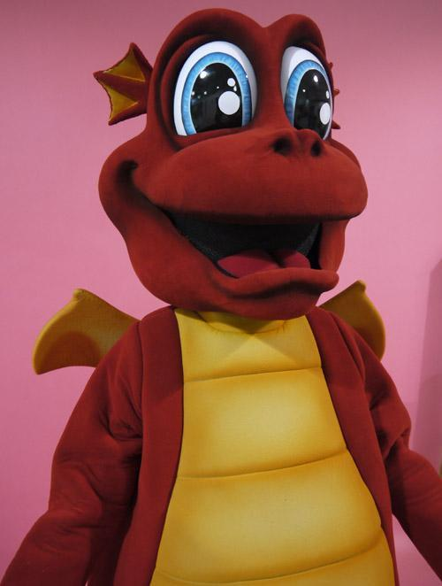
Dezzy the Dragon
Our mascot is Dezzy the Dragon
Look out for Dezzy as he attends club events throughout the year

Slide 4
2026 Soccer Schedule
Tuesday May 26th: Season starts for U3, U4/5 Tuesday only.
Monday May 25th: Season starts for U6/7 on Mondays
Wednesday May 20th: Season starts for U3, U4/5, U10/11
Thursday May 28th: Season starts for U6/7, U8/9
Tuesday July 1st: Canada Day - SESSION CANCELLED
The week of July 27th: Season ends
Please note that if you missed both uniform hand outs then we will give you your uniform at your field

Slide 5
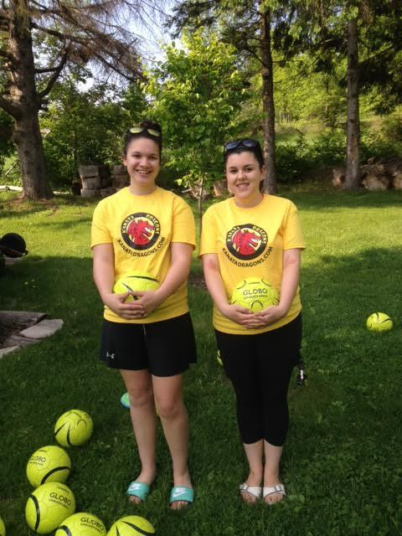
Field Marshals
Look out for a field marshal at your first session
Field marshals wear yellow Kanata Dragons T shirts
Field marshals will be able to assist you with any questions or concerns you may have about the Kanata Dragons

Slide 6
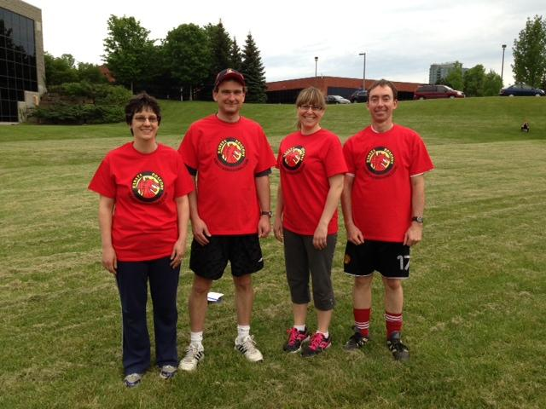
Coaches
All our coaches are parents who have volunteered to coach your child's team
Our coaches have been asked to wear a red Kanata Dragons T shirt so they are easy to spot
Please assist your child’s coach if asked to do so

Slide 7
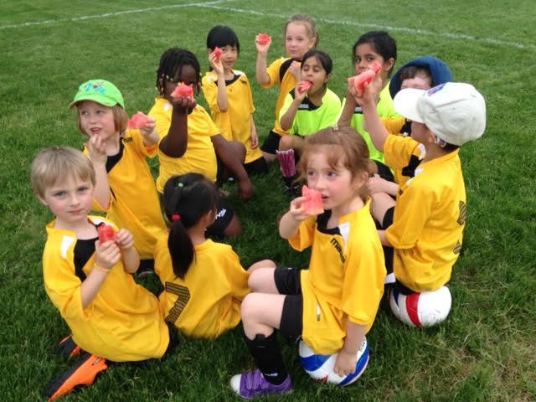
Snacks
It is club policy that coaches do not organize the snack roster
If your team decide to have snacks then we request that a parent who is not coaching volunteers to organize the snack roster
Please try to keep the snacks healthy and please no nuts

Slide 8

Inclement weather
With the exception of lightning, soccer always goes ahead
We believe that you know your child's tolerance to inclement weather better than we do
Parents are therefore asked to make their own decision if they wish to attend soccer in inclement weather
Should a session be cancelled it will not be rescheduled

Slide 9
Contacting the club
There are several ways that you can contact the club
  1. Speak to a field marshal on your opening soccer night
  2. Email the club at admin@kanatadragons.com
  3. Call the club answering machine at 613-470-0080 and leave a message

Slide 10
Parents
Please
  participate with your child when invited to do so by the coach
  do not smoke at the field
  leave your dog at home but if you have to bring your pet please ensure that the dog is on a leash at all times
  encourage and support your child
  respect your child’s coach and assist when requested
  park your vehicle responsibly when arriving at the field

Slide 11
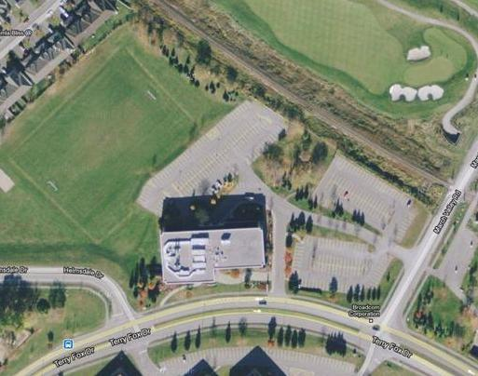
Parking at Somerton Park
Use the parking lot adjacent to the field
Enter parking lot from Terry Fox Drive here

Slide 12

Somerton Park
Bring bug spray
1
Field positions will change every week.
See program guide for details.
3
5
2
4
6
Parents Viewing Area
Parking Lot

Slide 13
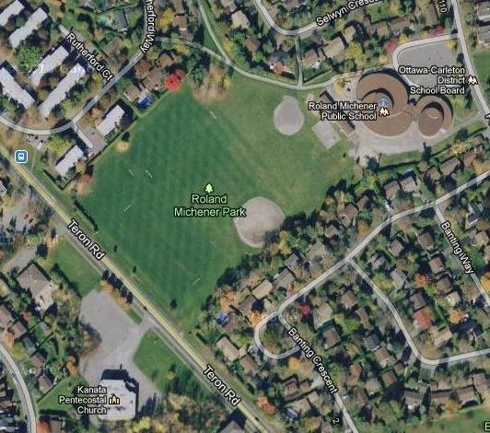
Parking at Roland Michener
Parking is at the school
Use street parking if the lot is full
There are 3 fields at Roland Michener School. Our field is shown in white
There is absolutely NO parking at the Church please.

Slide 14
Roland Michener – Monday
Parents Viewing Area
U6/7
Orange
U6/7
Purple
U6/7
Yellow
Parents Viewing Area
Teron Road

Slide 15
Roland Michener – Tuesday
Parents Viewing Area
U4/5
Bold Blue
U3
Power Red
U4/5
Yellow
U4/5
Power Red
U4/5
Maroon
Parents Viewing Area
Teron Road

Slide 16
Roland Michener – Wednesday
Parents Viewing Area
U4/5
Bold Green
U3
Yellow
U4/5
Orange
U4/5
Light Blue
U4/5
Light Grey
Parents Viewing Area
Teron Road

Slide 17
Roland Michener – Thursday
Parents Viewing Area
U6/7
Dark Green
U6/7
Bold Green
U6/7
Orange
Parents Viewing Area
Teron Road

Slide 18
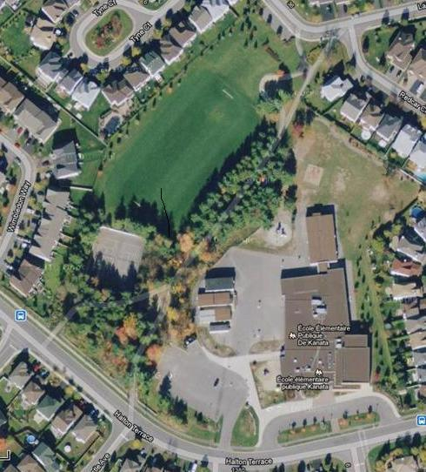
Parking at Klondike Park
There is a small parking lot at the school on Halton Terrace
Once that is full you will have to park on the street

Slide 19
Klondike Park – Monday
Parents Viewing Area
U6/7
Bold Green
Halton Terrace
Laxford Drive
U6/7
Purple
Parents Viewing Area

Slide 20
Klondike Park – Tuesday
Parents Viewing Area
U4/5
Light Blue
U3
Light Blue
U4/5
Dark Blue
Halton Terrace
Laxford Drive
U4/5
Dark Green
Parents Viewing Area

Slide 21
Klondike Park – Wednesday
Parents Viewing Area
U4/5
Light Blue
U3
Purple
U4/5
Power Red
Halton Terrace
Laxford Drive
U4/5
Maroon
Parents Viewing Area

Slide 22
Klondike Park – Thursday
Parents Viewing Area
U6/7
Yellow
Halton Terrace
Laxford Drive
U6/7
Bold Green
Parents Viewing Area
Notes:
UPDATE

Slide 23


