Slide 1
August Program
2024

Slide 2
About the program
A 5 week program where players can continue to learn the game
Players register for Tuesday or Thursday evenings
Players should wear their uniform from the summer program if they have one. This is not mandatory
Uniforms will be available for purchase prior to the first session - $20 for shirt, shorts, socks and ball. Cash only
Players will be informed which team they are on prior to the first session
Snacks will be provided by the Kanata Dragons
Each session is 1 hour long starting at 6:00pm
All sessions are on the artificial turf at the Richcraft Recreation Centre
The price to register for the program is $89

Slide 3
Schedule
Tuesday Program
Thursday Program

Slide 4
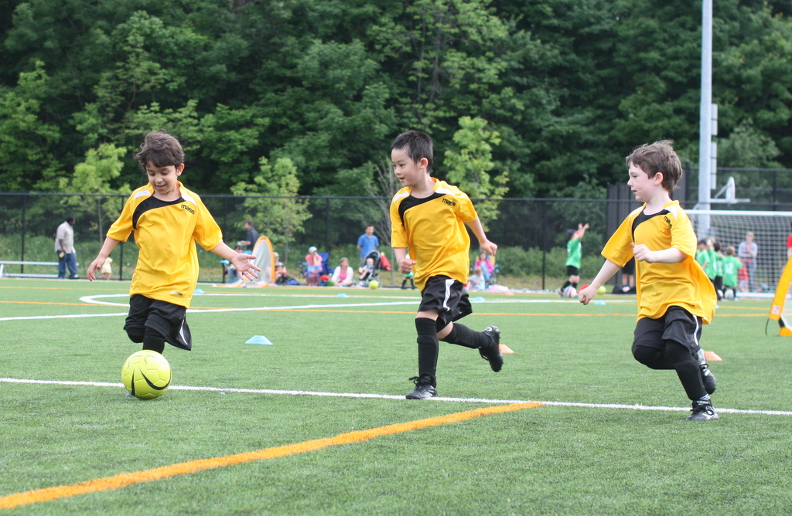
Richcraft Recreation Complex field
All games will be at the Richcraft Recreation Complex turf field

Slide 5

Team Location
Bring bug spray if you sit on this side
Parents Viewing Area
Under 4/5A
Main
parking
lot
Under 8 – 11A
Under 8 – 11B
Under 6/7A
Under 4/5B
Under 6/7B
Small
parking
lot
Under 3
Parents Viewing Area
Bleachers
Entrance
Entrance
Innovation Drive

Slide 6
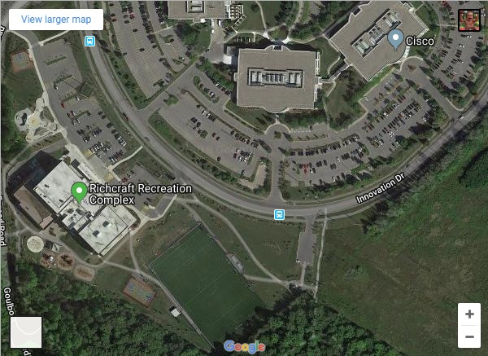
Parking at Richcraft Recreation Centre
Main parking lot
Smaller parking lot
If the parking lots are full use street parking or park in the office parking lots across the street
Soccer field
Uniforms for sale
Playground & splash pad

Slide 7


